Slide 1
Comparison of the performance of learning algorithms for verification of phishing uniform resource locator (URLs) using machine learning.
By: Loide M Kephas
Student Number:201401571
Faculty of Science
School of computing
Main supervisor: Mr. G. T. Nhinda
Co-supervisor: Dr. N. Suresh

Slide 2
Outline
Introduction
Problem statement (s)
Research objectives
Motivation
Literature Review
Methodology ( Research and Development)
Screen short of my work
Discussion of the Results obtained
Conclusion
Challenges and future works
References

Slide 3
Introduction
Phishing is an online criminal act that occurs when a malicious webpage mimics as a legitimate webpage so as to acquire sensitive information from the user [1].
Phishing attack have been on the rise and performing certain action such as hovering or clicking on malicious URLs may cause unsuspecting internet user to fall victim of scams or identity theft [2].
Detecting phishing websites is one of the crucial problems facing the internet community because of its high impact on the day-to-day online transactions performed.
The main function of these prototype is to gain a better understanding on the performance of the three learning algorithms, based on the information gathered.

Slide 4
Problem statement(s)
The fast growth and progress of phishing techniques create several challenge in web security.
Security analysts throughout the world are constantly challenged by the phishing community as new and advanced methods are developed each day.
Namibia has experienced its own share in cyber-attacks in the ream of electronic banking transactions which prompt the Namibia government to come up with a draft bill on electronic transactions and cybercrime [3].
Despite a number of solutions to mitigate phishing by previous researchers, there is still no conclusive solution to phishing attacks particularly in the universities environment, and university of Namibia (UNAM) is not an exception.
Currently at UNAM there is Cyberoam in place, but very little study is been done on the performance study.
Hence the mail server still receive phishing URL’s and (IT) infrastructure department staff, had to warn the users not to open such emails.

Slide 5
Motivation
The researcher herself had received spam emails claiming she won a huge amount of money and to click on the provided links.
The researcher also found out that staff members from the University of Namibia had been receiving emails from computer centre about phishing URLs.
So the researcher believes that suspicious URLs in the cyberspace continue to pose a threat, which gives room to improve the existing systems by doing more research.

Slide 6
Objectives of the study
The main objective of this study:
To evaluate the performance of learning algorithms for verification of phishing URLs using machine learning.
The sub-objectives of the study:
To determine which of the three algorithms is suitable for predicting phishing URLs.
To use standard metrics for measuring the performance of the learning algorithms (Naïve Bayes classifier, Decision Tree and Logistic Regression) to benchmark the performance of the algorithms.
To evaluate each algorithmic model from the perspective of accuracy, precision, recall and F-measure and receiver operating characteristic/ area under the curve.

Slide 7
Literature Review
Basnet and sung [4], proposed a novel approach for classifying legitimate and malicious URLs using supervised learning across the features from various web services.
Azeez and Oluwatosin [5], explored on how malicious link in emails can be detected from lexical and host-based features of their URLs to protect users from identity theft attacks using Naïve Bayesian classifier.
E and K [6], proposed a system that uses lexical features WHOIS features, PageRank and Alexa Rank and PhishTank -based features on random forest and content-based algorithms to classify phishing URLs.
Ma et al. [7] explore an online learning approach for classifying URLs automatically as either malicious or benign, based on supervised learning across both lexical and host-based features.

Slide 8
Methodology
Research approach
Quantitative method with experimental research
Population
Legitimate and Phishing URLs
Sample size
Dataset consist of 7030 URLs
Sampling technique
Purposive sampling
Data collection method
Manually captured
Downloaded from GitHub repository
Data analysis
Confusion matrix
Classification report

Slide 9
Software development Methodology
Methodology: Personal Extreme Programing (PXP)
Requirements
Literature Review
Experiment
Observation
Design and development
Models where designed, developed, trained and tested in iterations. In addition, the models were trained and tested until they are able to verify/classify URLS.
Testing
Integration testing of the prototype was done by testing how parts of the model work together.
Software development toolkit
Anaconda3, python, Jupyterlab, Numpy, Scikit-learn, Pandas, Matplotlib

Slide 10
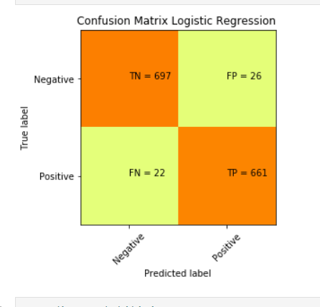
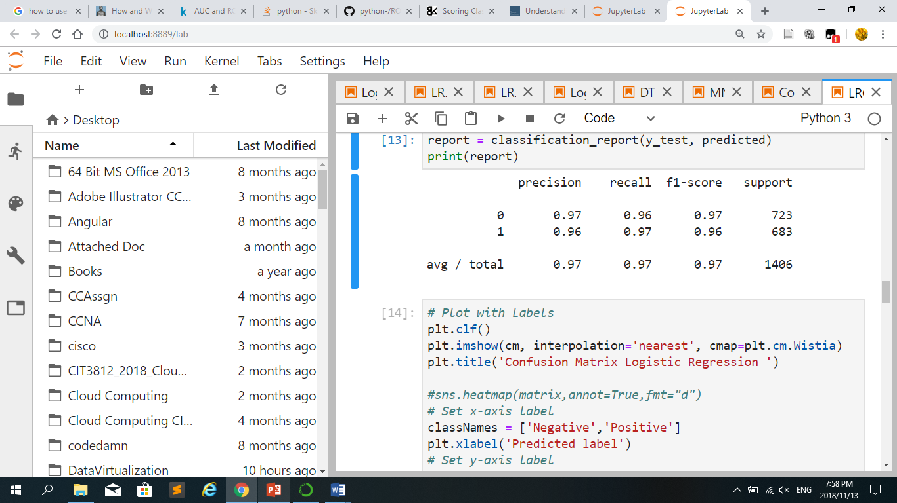
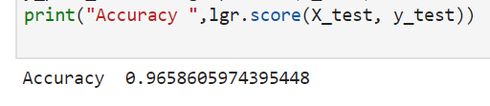
Prototype models training and testing results Logistic regression results
Classification report

Slide 11
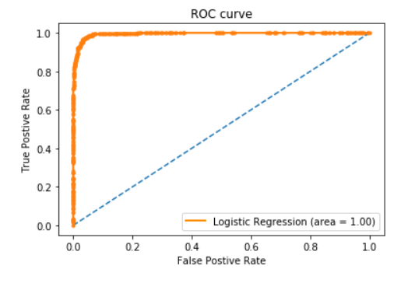
Logistic regression ROC curve
The image show the area under curve/receiver operation characteristic

Slide 12

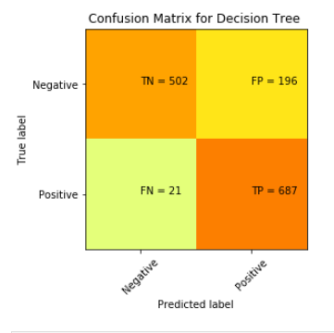
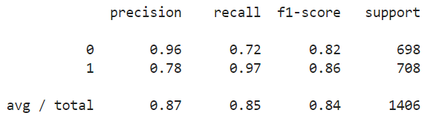
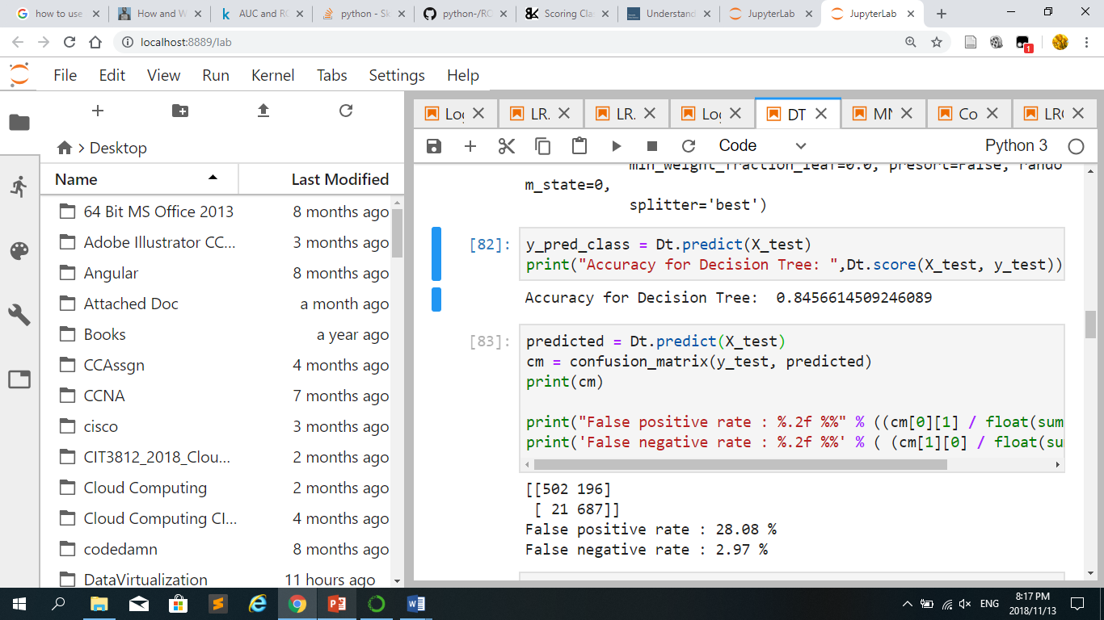
Decision Tree results

Slide 13
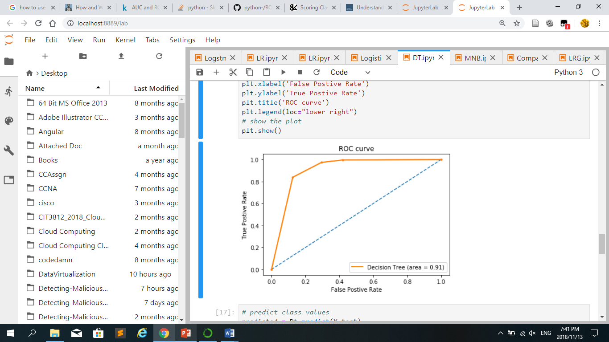
Decision Tree ROC Curve
The image show the area under curve/receiver operation characteristic

Slide 14

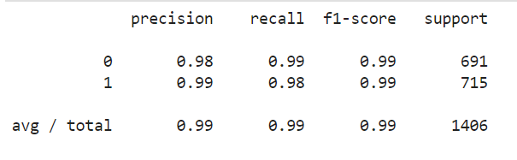
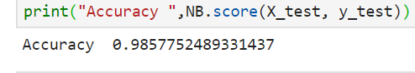
Naïve Bayesian results
Classification report

Slide 15
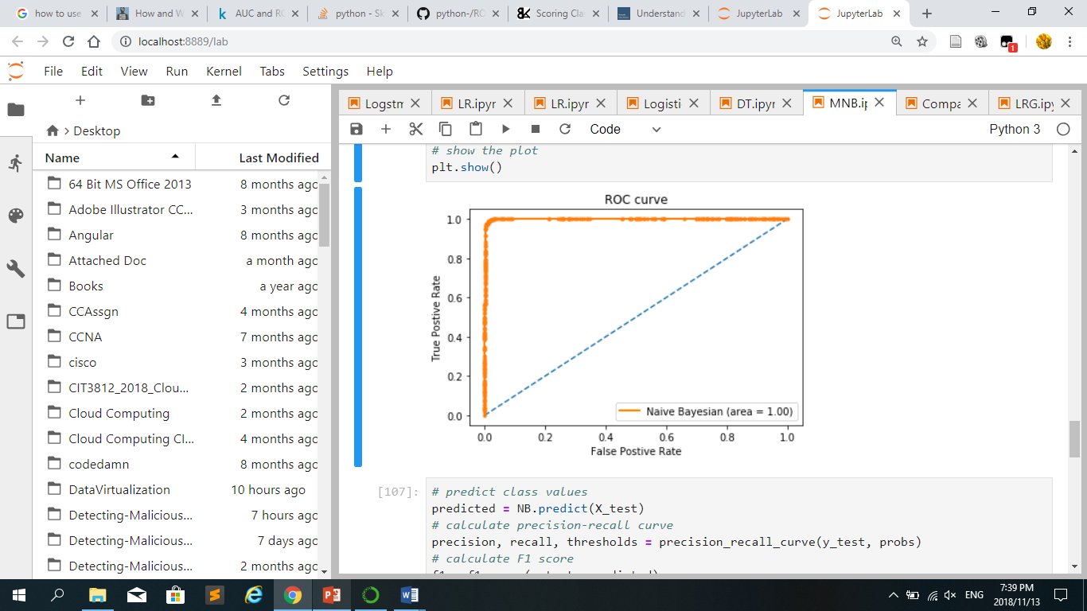
Naïve Bayesian ROC curve
The image show the area under curve/receiver operation characteristic

Slide 16
Discussion of the Results obtained
Testing of the models involved determining how well the models were able to verify/classify the URLs.
The performance of the models were measured by giving each model a set of test URLs and the number of correct and incorrect results were recorded using a confusion matrix. In addition, classification report and area under the cure (AUC)/ receiver operating characteristic curve(ROC) was also used to show the results.
Naïve Bayesian model was identified as the suitable model with the accuracy of 99% as compare to Logistic regression with 97% and Decision tree with 86% accuracy.

Slide 17
Conclusion
The models were developed, trained, tested and the result were compared, thus the researcher met the research objectives.
The study was significant as it provide a better understanding on two or more machine learning algorithms that could be employed to verify and confirm legitimate and phishing URLs in the cyberspace.

Slide 18
Challenges and Future work
Only one data set is used for both training and testing.
Assembling the program to do the actual work of training and testing the models.
Overfitting with Decision Tree
Graphing area under the curve/receiver operating characteristic , precision and Recall
This is resolved by utilising the libraries and documentation provided by Scikit-learn.
Future Works
It would be interesting to investigate what makes each of the model perform the way they do, which may be form the score each model had achieved in predicting URLs, or resources used, time and computational power during training and testing.
Investigation on the impact of feature extraction.
This algorithms were tested with standard dataset, therefore they can be tested with newer dataset in the future.
Spear phishing Attack

Slide 19
References
[1] S. Marchal, J. François, R. State, and T. Engel, “PhishStorm: Detecting Phishing With Streaming Analytics,” IEEE Trans. Netw. Serv. Manag., vol. 11, no. 4, pp. 458–471, Dec. 2014.
[2] P. D. Dudhe and P. L. Ramteke, “Detection of Websites Based on Phishing Websites Characteristics,” vol. 3, no. 4, p. 7, 2007.
[3] N. E. S. Reporter, “Cybercrime a threat to national security – Shanghala,” New Era Newspaper Namibia, 15-May-2018.
[4] R. B. Basnet and A. H. Sung, “Mining Web to Detect Phishing URLs,” in 2012 11th International Conference on Machine Learning and Applications, 2012, vol. 1, pp. 568–573.
[5] N. A. Azeez and A. Oluwatosin, “CyberProtector: Identifying Compromised URLs in Electronic Mails with Bayesian Classification,” in 2016 International Conference on Computational Science and Computational Intelligence (CSCI), 2016, pp. 959–965.
[6] B. E. and T. K., “Phishing URL Detection: A Machine Learning and Web Mining-based Approach,” Int. J. Comput. Appl., vol. 123, no. 13, pp. 46–50, Aug. 2015.
[7] J. Ma, L. K. Saul, S. Savage, and G. M. Voelker, “Beyond blacklists: learning to detect malicious web sites from suspicious URLs,” 2009, p. 1245.

Slide 20

Any Question, Comment or Suggestion

